Slide 1
Flight Cancellation By State
Insight 1
https://public.tableau.com/profile/sadhna.vaishnav#!/vizhome/FlightCancellationByState_16136176754900/Dashboard1?publish=yes
From this Dashboard we can see where the most cancellation occur. It appears that most cancellation happen in Texas 668 flights got cancelled out of 32,612 total flights and in Illinois 563 flights got cancelled out of 19,678 total flights.
West Virginia and Montana had the fewest number of cancellations with only 3.
I used color blue for the bar chart instead of using multiple colors like red, yellow, pink it distracts the visuals. You can see the count easily and clearer this way.

Slide 2
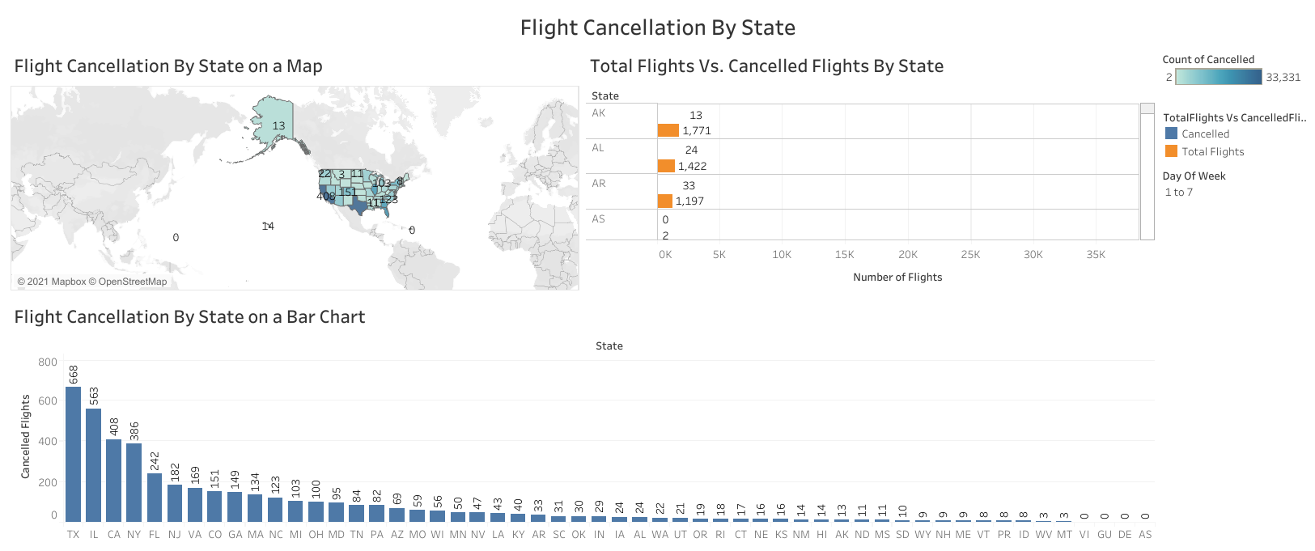
Flight Cancellation By State Dashboard

Slide 3
Flight Delay By Airport
Insight 2
https://public.tableau.com/profile/sadhna.vaishnav#!/vizhome/FlightDelayByAirport/Dashboard1?publish=yes
From this Dashboard we can see which airport has the highest delay. It appears that Chicago O’Hare International Airport has the highest delay.
We can also see that what type of delay is the highest or most common that occurs. Looking at stacked chart we find that Departure Delay is the highest. I have used color blindness palette for categorical data which will help any one including color blind individual to view the visuals easily.
Line chart is a good visual to see the result over time. I used Line chart to see the delay by month to see which month has most delay in particular category. Weather Delay is the highest delay in all other types of delay.
Text table summarize all the details about different type of delay by airport.

Slide 4
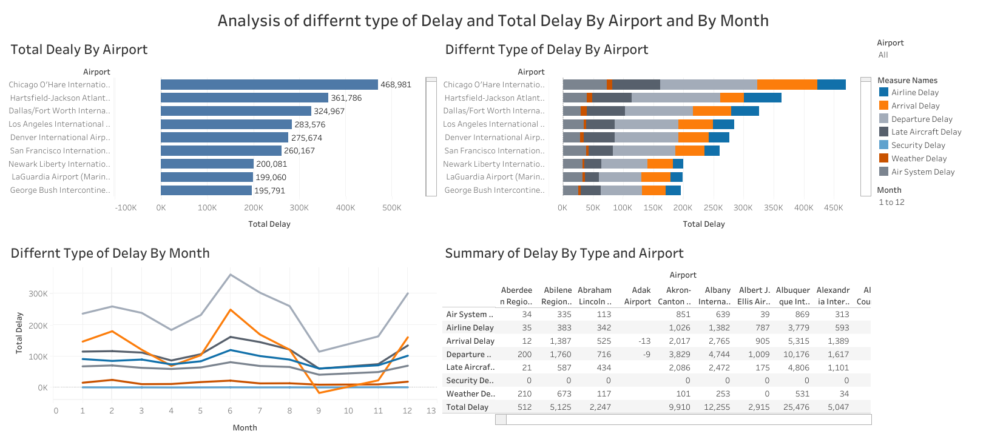
Flight Delay By Airport Dashboard

Slide 5
Airport and Airline Analysis
Insight 3
https://public.tableau.com/profile/sadhna.vaishnav#!/vizhome/AirportandAirlineAnalysis/Dashboard1?publish=yes
From this dashboard one can find about which airport is the busiest Airport. There is a bar chart showing top 10 busiest airport. Hartsfield-Jackson Atlanta International Airport is the busiest airport and operating 17,833 flights.
While another bar chart is showing which airline has the most flights. Looking at the chart Southwest Airline has the total 59,437 flights while Virgin America has the least number of flights 2,978.
3rd chart I have is about total flights group by airline and airport. We can find out about which airport has main hub of the airline. For example, Dallas/Fort Worth International airport has highest flights of American Airline and Hartsfield-Jackson Atlanta International Airport has highest flights of Delta Airline.
I also found a relationship between Distance to Delay by using scatter chart. Scatter plots are useful for displaying bivariate numerical data. This means a data set with two variables, such as distance and delay measurements for a list of flights.
If the data of both variables moves up together, they have a positive correlation, and this can be seen in the scatter plot, such as in the following plot of flight Distance and Delay data. We can see that generally, as distance increases, so does delay.

Slide 6
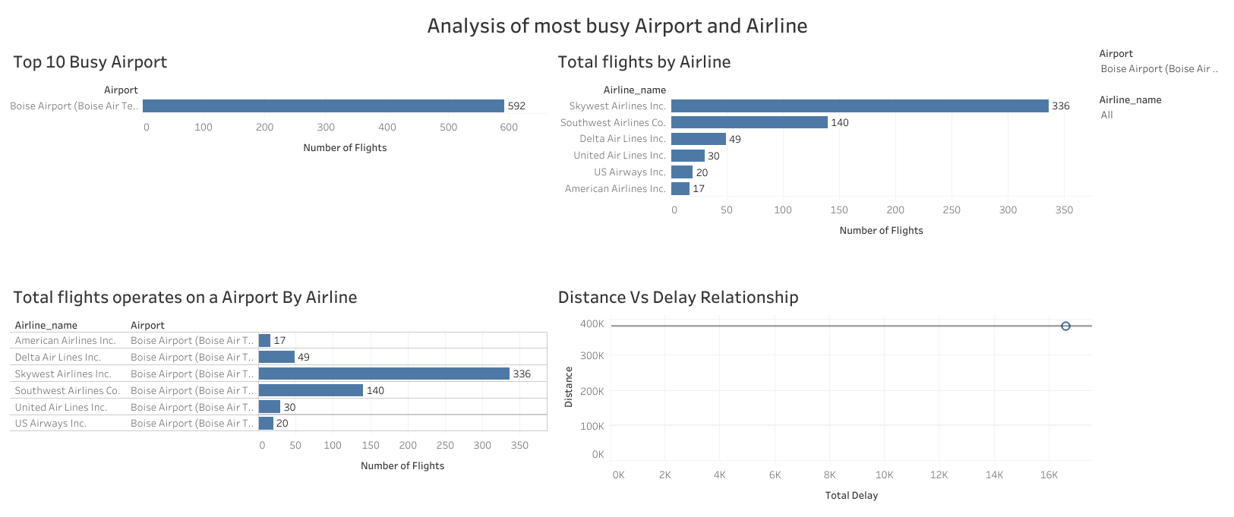
Airport and Airline Analysis Dashboard

